Slide 1
Java File Handling
by B. Molutov

Slide 2
Java Files
File handling is an important part of any application.
Java has several methods for creating, reading, updating, and deleting files.
The File class from the java.io package, allows us to work with files.
To use the File class, create an object of the class, and specify the filename or directory name: # see code example “E1.java”

Slide 3
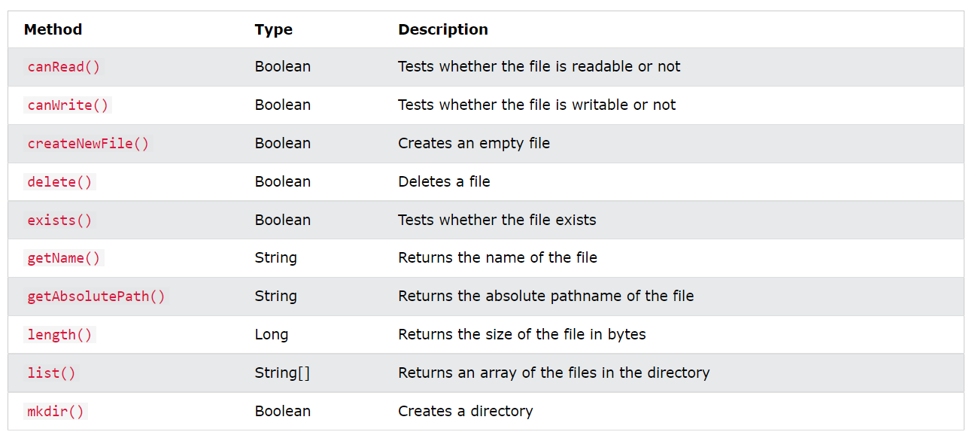
Methods for creating and getting info about files

Slide 4
Create a file
To create a file in Java, you can use the createNewFile() method. This method returns a boolean value: true if the file was successfully created, and false if the file already exists. Note that the method is enclosed in a try...catch block. This is necessary because it throws an IOException if an error occurs (if the file cannot be created for some reason): # see code example “E2.java”

Slide 5
Write to a file
In the following example, we use the FileWriter class together with its write() method to write some text to the file we created in the example above. Note that when you are done writing to the file, you should close it with the close() method: # see code example “E3.java”

Slide 6
Read files
In the following example, we use the Scanner class to read the contents of the text file we created in the previous chapter: # see code example “E4.java”

Slide 7
Get file information
To get more information about a file, use any of the File methods: # see code example “E5.java”

Slide 8
Delete a file
To delete a file in Java, use the delete() method: #see code example “E6.java”

